Slide 1
Compounds Containing Hydrogen (Acids and others)
The names of molecular compounds containing hydrogen do not usually conform to the systematic nomenclature guidelines.
Many are called by the common, nonsystematic names or by names that do not indicate explicitly the number of H atoms present.
Examples (do not need to memorize all these, should know familiar ones like ammonia, water):
B₂H₆ Diborane
SiH₄ Silane
NH₃ Ammonia
PH₃ Phosphine
H₂O Water
H₂S Hydrogen sulfide

Slide 2
Use these Slides in Present Mode: on the practice slides the yellow boxes will disappear on click AFTER you have tried them. Please WRITE your answers, don’t just think them. Writing or speaking completes the thinking process and promotes MUCH better learning.
TECH SOLUTIONS
Look for this box throughout for alternative methods for those with slower internet etc. HINT: you can work in Offline mode after accessing once on a device (under file OR settings, depending on device) OR you can print the presentation. It has all the information and you can access the videos as needed when possible.

Slide 3
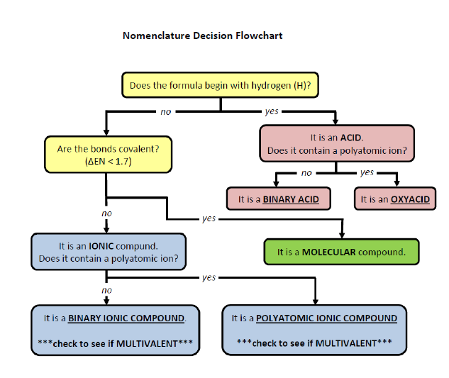

Slide 4
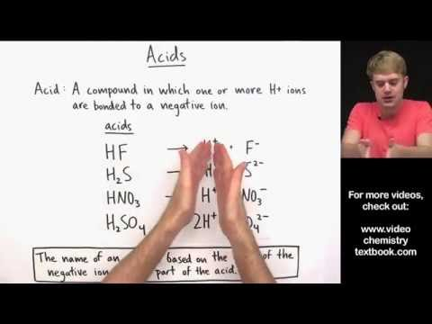
Video Description OR Skip to Written if preferred.
Click HERE to go to Slide with Video with Practice problems to try

Slide 5
Pneumonic for recalling the patterns you will learn
“My ride has hydrolics, I ate something icky, and Sprite is delicious.”

Slide 6
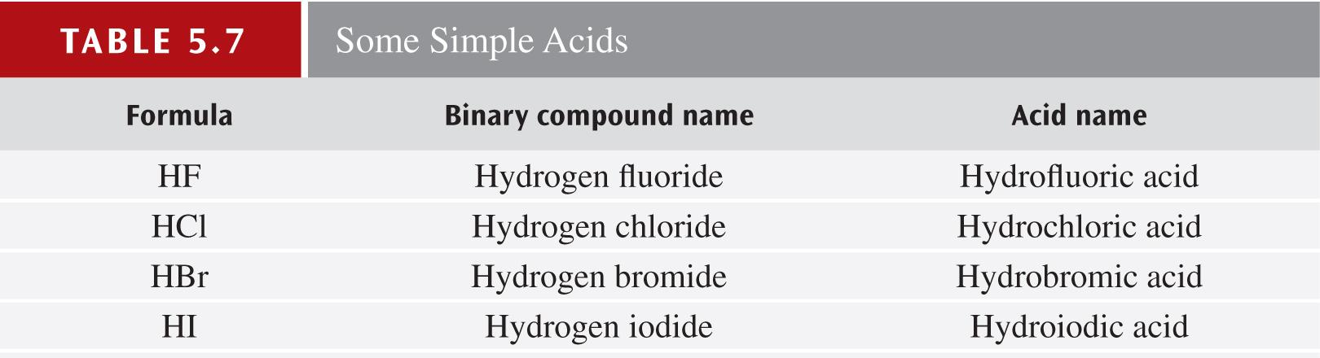
Acid-Forming Compounds
A compound must contain at least one ionizable hydrogen atom (forms an H+ ion in water) to be an acid upon dissolving.

Slide 7
Naming Acids: Binary acids
All acids start with H (e.g. HCl, H₂SO₄)
TWO acid types exist: binary acids and oxyacids
Binary Acids: H + non-metal. E.g. HCl
Oxyacids: H + polyatomic ion. E.g. H₂SO₄

Slide 8
ACIDS
The two acid types have different naming rules.
Binary acids: naming depends on state → the molecules only have acidic properties when dissolved in water (aqueous state).
• If it’s NOT aqueous it is named with ionic rules:
hydrogen + non-metal name
eg. HCl_{(g)} = hydrogen chloride
•If it IS aqueous: hydro + non-metal + ic acid
HCl_{(aq)} = hydrochloric acid

Slide 9
Pneumonic for recalling the patterns you will learn
My ride has hydrolics matches this naming pattern

Slide 10
Practice (Present mode!- pay attention to state
HBr_{(s)} hydrogen bromide
HI_{(aq)} hydroiodic acid
H₂S_{(aq)} hydrosulfuric acid
H₂S_{(g)} hydrogen sulfide
TECH SOLUTIONS
See slides at the end without the boxes. If printed off or working in offline mode, cover the answers and attempt to name.

Slide 11
Naming Acids: Oxyacids
Click to watch a video on naming oxyacids with practice for simple acids as well. The rules are written on the next slide for you.
Practice questions are embedded. Please attempt them for your learning but they are NOT formally assessed.
TECH SOLUTION
Link to youtube video without embedded questions for those with limited internet access. Use printable resources to practice.

Slide 12
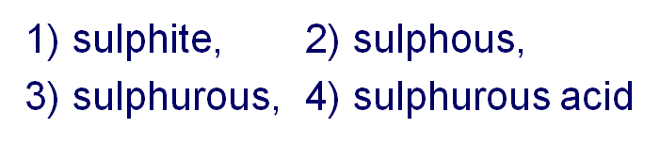
Naming Acids: Oxyacids
1) name the polyatomic ion
2) replace ate with ic OR ite with ous
3) change non-metal root for pronunciation (eg sulphuric is nicer to say than sulphic)
4) add “acid” to the name
E.g. H₂SO₃→ follow steps #1-4 above:
Final name

Slide 13
Pneumonic for recalling the patterns you will learn
I ate something icky, and Sprite is delicious.”
This part of the pneumonic matches these naming rules

Slide 14
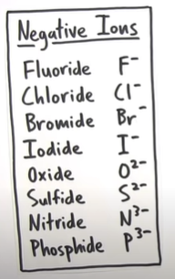
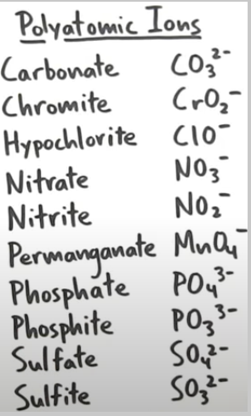
Rule Summary & Exceptions
Acids
-Compound where one or more H+ ions are bonded to a negative ion
Binary Acids
-Hydrogen + Nonmetal
Binary compound name→ide
Ex. HF_{(g)} Hydrogen fluoride
- Acid name
ide→Hydro____-ic acid
Ex. HF_{(aq)} = Hydrofluoric acid
Oxyacids
- H + polyatomic ion
ate → -ic acid
Ex. H₂CO₃ = Carbonic acid
ite → -ous acid
Ex. HNO₂ = Nitrous acid
Important exceptions(polyatomic ion):
-phosphate= phosphoric acid
-Phosphite=Phosphorous acid
-Sulfate=Sulfuric acid
-Sulfite= Sulfurous acid
Notes:
Binary compound name→ide
ate → -ic acid
ite → -ous acid
molecular compounds containing hydrogen(familiar ones)
NH₃=Ammonia
H₂O=Water

Slide 16
Practice (in present mode, boxes disappear on click after you try them.
nitrous acid
phosphoric acid
HClO_{(aq)}
H₂CO_{3(aq)}
HNO_{2(aq)}
H₃PO_{4(aq)}
hypochlorous acid
carbonic acid
TECH SOLUTIONS
See slides at the end without the boxes. If printed off or working in offline mode, cover the answers and attempt to name.

Slide 17
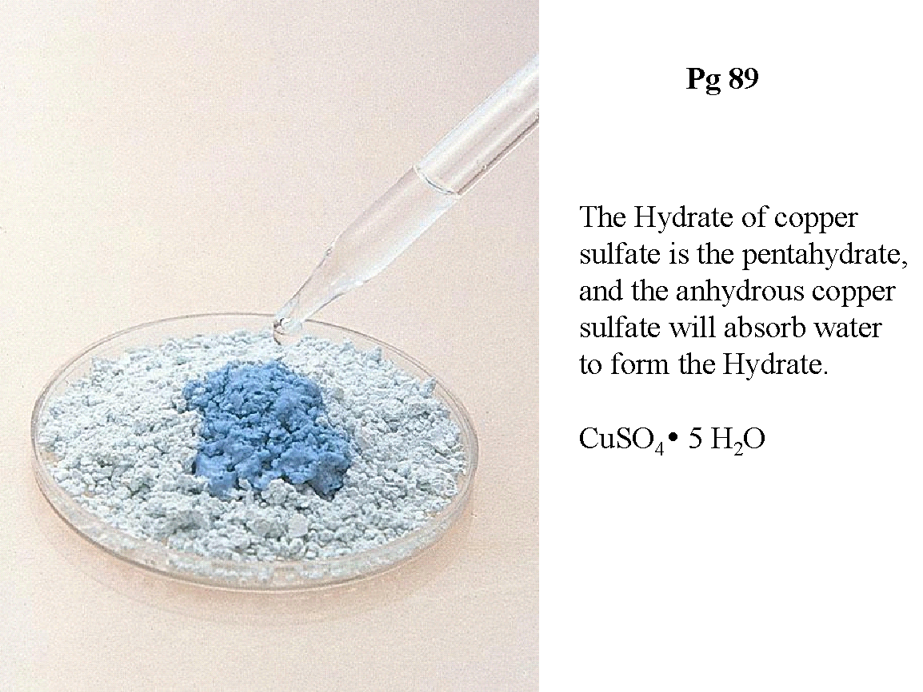
Special Nomenclature Case - Hydrates
A hydrate is an ionic compound that has water molecules incorporated into their solid structures.
NOTE: these are NOT acids. ANY ionic compound that does this with water is a hydrate.
Writing the formula: name of ionic compound · #H₂O
Copper(II)sulfate.pentahydrate
Olmsted Williams

Slide 18
Special case → Hydrates
A hydrate is a compound that has a specific number of water molecules trapped within its solid structure. The water trapped in the solid crystal is called the water of hydration.
For example, in its normal state, copper(II) sulfate has five water molecules associated with it. Name compound as usual. Add hydrate with the prefix indicating the number of water molecules.
Systematic name: copper(II) sulfate pentahydrate
Formula: CuSO₄ ∙ 5H₂O
Some other hydrates are
BaCl₂ ∙ 2H₂O
LiCl ∙ H₂O
MgSO₄ ∙ 7H₂O
Sr(NO₃)₂ ∙ 4H₂O
Note the dot between the main compound and associated water molecules.

Slide 19
Optional 3 minute video on Hydrates
Click here
{FYI, I can’t embed the ones with questions inserted into Slides)

Slide 20
Hydrates - Anhydrous
When the water molecules are driven off by heating, the resulting compound, CuSO₄, is sometimes called anhydrous copper(II) sulfate.
Anhydrous means the compound no longer has water molecules associated with it.
This is why we use a dot in the formula because the heating of the compound removes the ASSOCIATED water molecules but does not alter the salt formula OR properties. The water is NOT bound to or part of the salt.

Slide 21
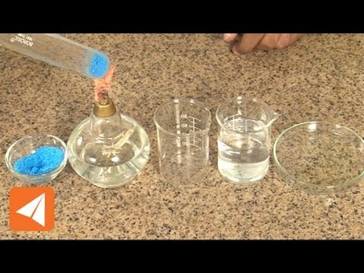
Watch a Hydrate Expt (<3mins)
{Not req’d if you have tech challenges but good to watch if possible}

Slide 22

RECALL: Bases & Naming
Reminder: A base can be defined as a substance that yields hydroxide ions (OH⁻) when dissolved in water. There are no special naming rules for bases.
NaOH
sodium hydroxide
KOH
potassium hydroxide
Ba(OH)₂
barium hydroxide

Slide 23
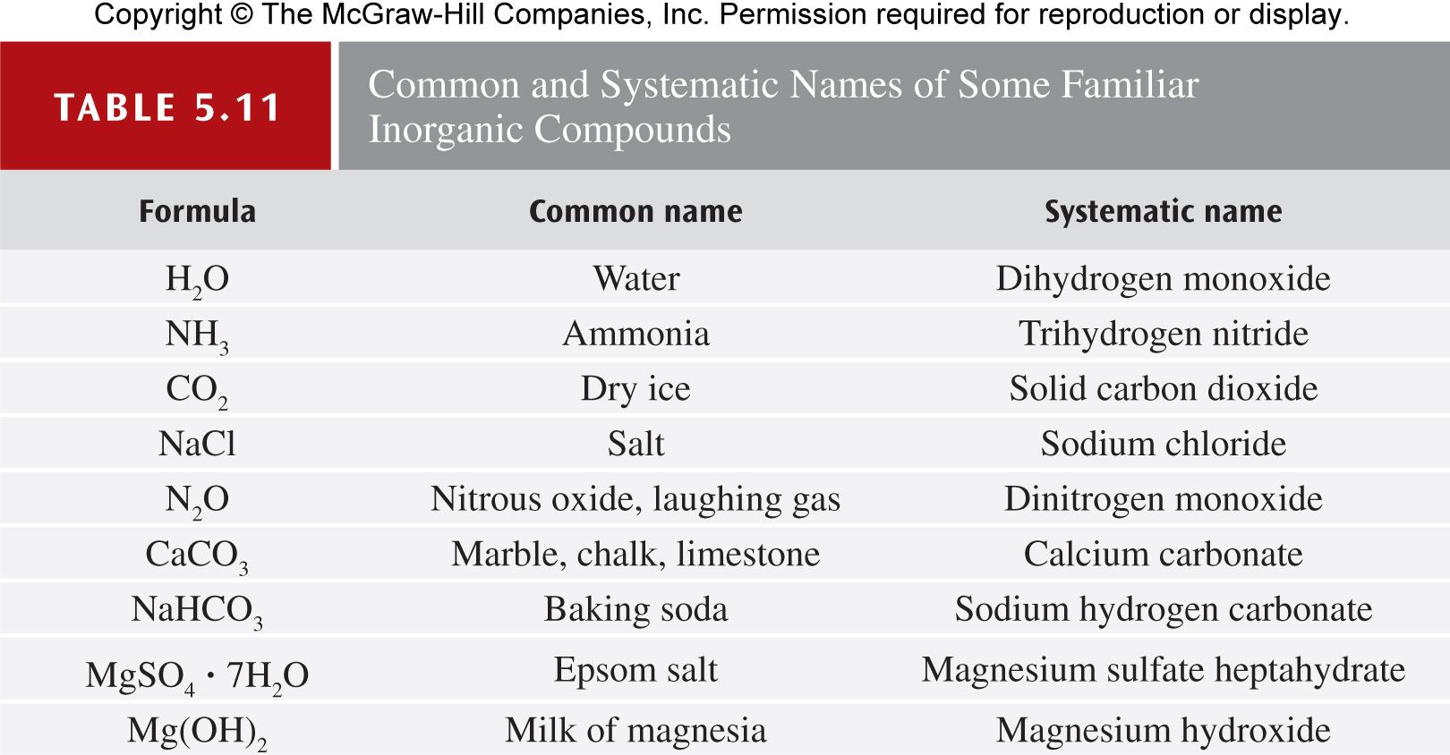
For Interest : Familiar Compounds

Slide 24
If you are feeling confident, you CAN STOP HERE and continue to the nomeclature sheets practice on the unit plan. Remaining slides provide more Worked examples and another video for those that need further assistance.

Slide 25
Worked Example 5.10
Name the following species: (a) BrO₄⁻, (b) HCO₃⁻, and (c) H₂CO₃.
Strategy Each species is either an oxyanion or an oxyacid. Identify the “reference ion” (the one with the –ate ending) for each, and apply the rules to determine appropriate names.
Solution (a) BrO₄⁻ has one more O atom than the bromate ion (BrO₃⁻), so BrO₄⁻ is the perbromate ion.
(b) CO₃²⁻ is the carbonate ion. Because HCO₃⁻ has one ionizable hydrogen atom, it is called the hydrogen carbonate ion.
(c) With two ionizable hydrogen atoms and no charge on the compound, H₂CO₃ is carbonic acid.

Slide 26
Worked Example 5.11
Determine the formula of sulfurous acid.
Strategy The –ous ending in the name of an acid indicates that the acid is derived from an oxyanion ending in –ite. The oxyanion must be sulfite, SO₃²⁻, so add enough hydrogen ions to make a neutral formula.
Solution The formula of sulfurous acid is H₂SO₃.
Think About It Remembering all these names and formulas is greatly facilitated by memorizing the common ions that end in -ate.

Slide 27
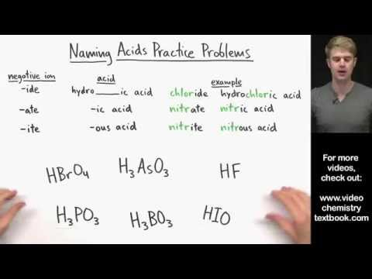
Naming acids practice

Slide 28
Tech solutions:
Remainder of Slides are duplicates of above to help those with tech challenges.
Stop here if you were able to fully access the presentation above.

Slide 29
Practice (Present mode!- pay attention to state
HBr_{(s)} hydrogen bromide
HI_{(aq)} hydroiodic acid
H₂S_{(aq)} hydrosulfuric acid
H₂S_{(g)} hydrogen sulfide
TECH SOLUTIONS
See slides at the end without the boxes. If printed off or working in offline mode, cover the answers and attempt to name.

Slide 30
Practice (in present mode, boxes disappear on click after you try them.
nitrous acid
phosphoric acid
HClO_{(aq)}
H₂CO_{3(aq)}
HNO_{2(aq)}
H₃PO_{4(aq)}
hypochlorous acid
carbonic acid

